Slide 1
From Heart to Brain:
The Secret Life of Mounjaro
Presented by: Dr. Bob Sangar

Slide 3
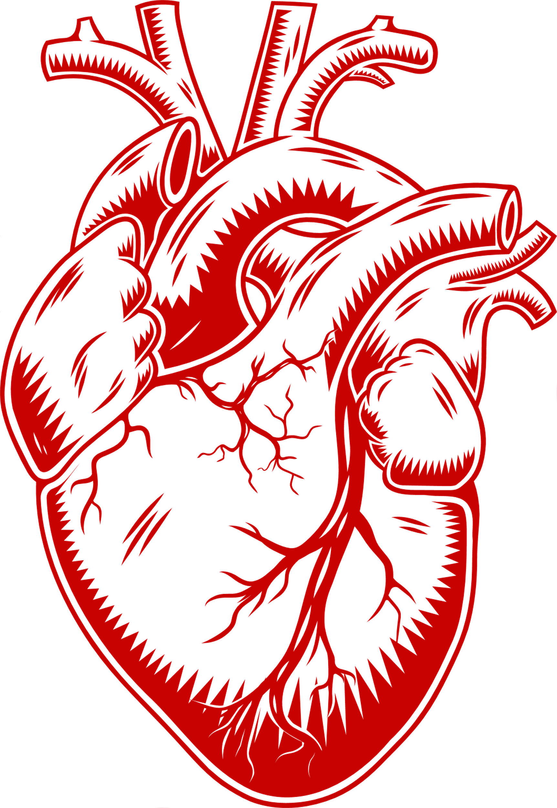
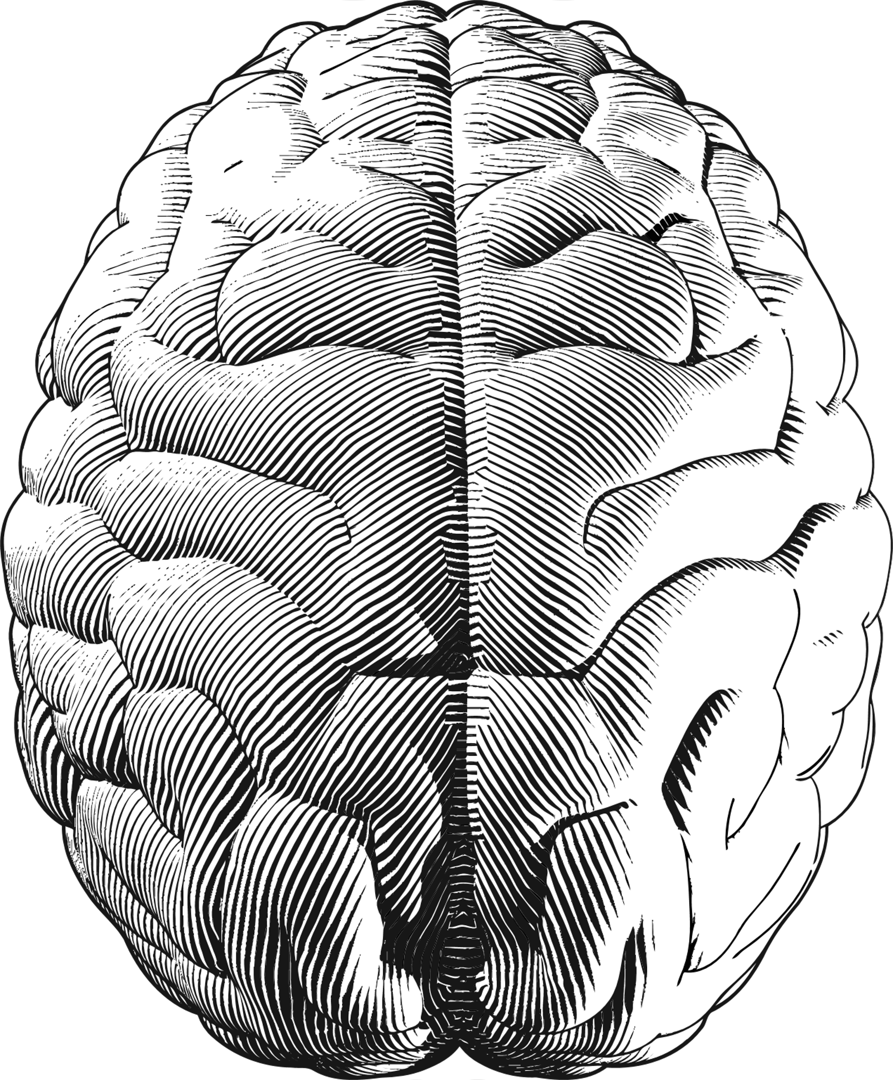
From Heart to Brain

Slide 4
Definitions
Peptides
short chain of amino acids, typically < 50
act as signalling molecules
Incretins
gut-derived peptides
released after eating
↑insulin secretion from pancreas
GLP-1: Glucagon-like Peptide-1
GIP: Glucose-dependent insulinotropic polypeptide

Slide 5
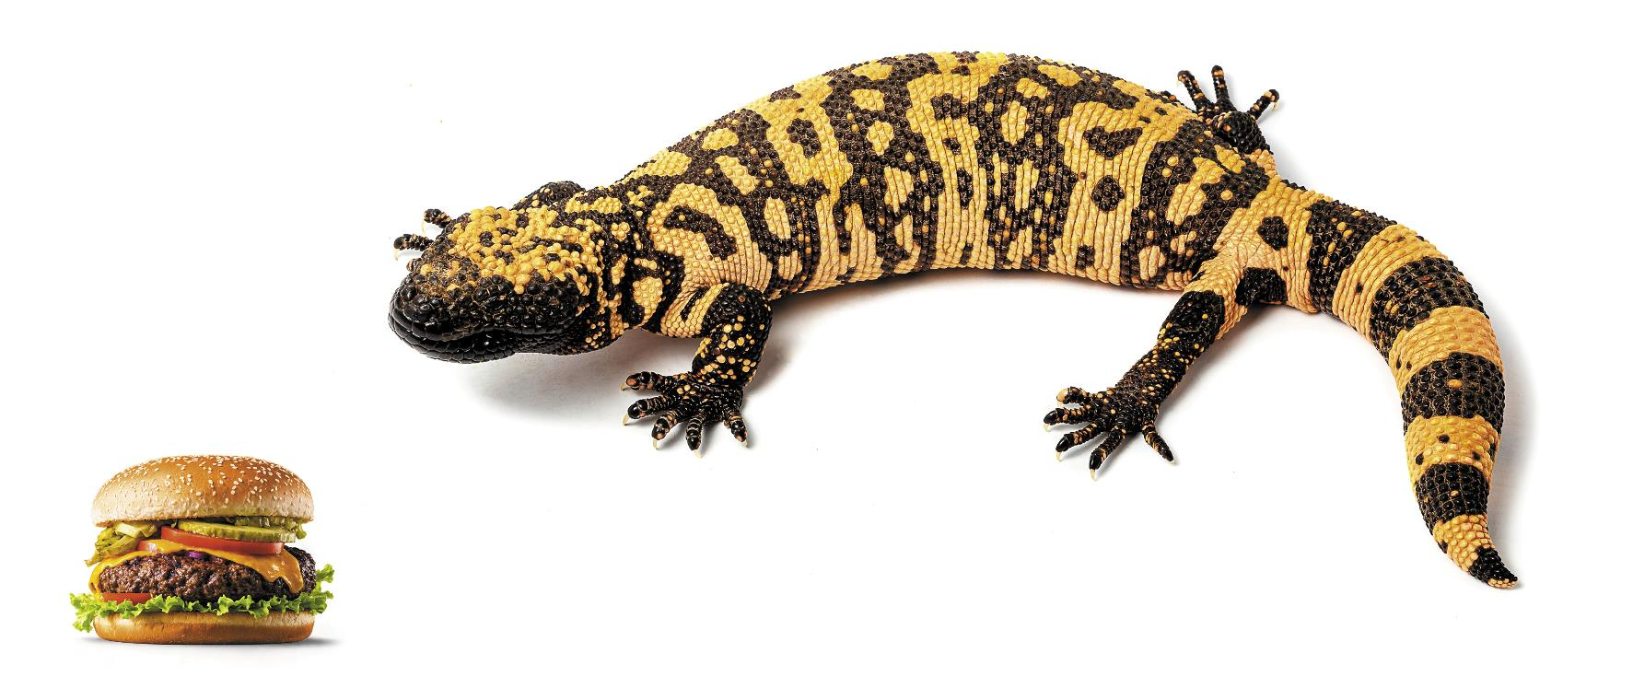
The Gila Monster

Slide 6
History

Slide 7
The Incretin Cast – GLP‐1 & GIP
GLP-1s: ↑ Insulin, ↓ Glucagon ↓ Appetite
Exenatide
Liraglutide
Dulaglutide
Semaglutide - Ozempic / Wegovy
GIPs: ↑ Insulin secretion, alter fat metabolism
GLP-1 + GIP: Tirzepatide – Mounjaro
GLP-1 + GIP + GCGR (glucagon): Retatrutide - Phase 3 trials

Slide 8
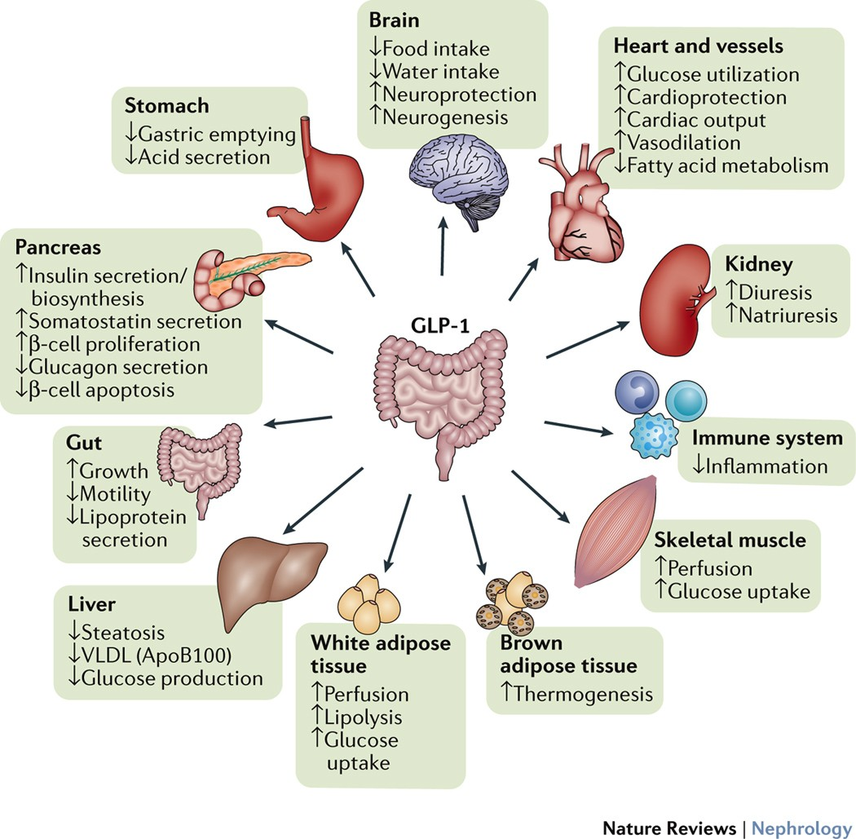
The Double Agent: GLP-1

Slide 9
GLP-1 vs GIP

Slide 10
Cardiovascular Triumph – More than Glucose
13-26% MACE reduction vs placebo
Patients with optimal Rx e.g statins, ACE
Could it be just the weight loss?
LEADER & SUSTAIN-6: MACE reduction appeared early & before major weight loss

Slide 11
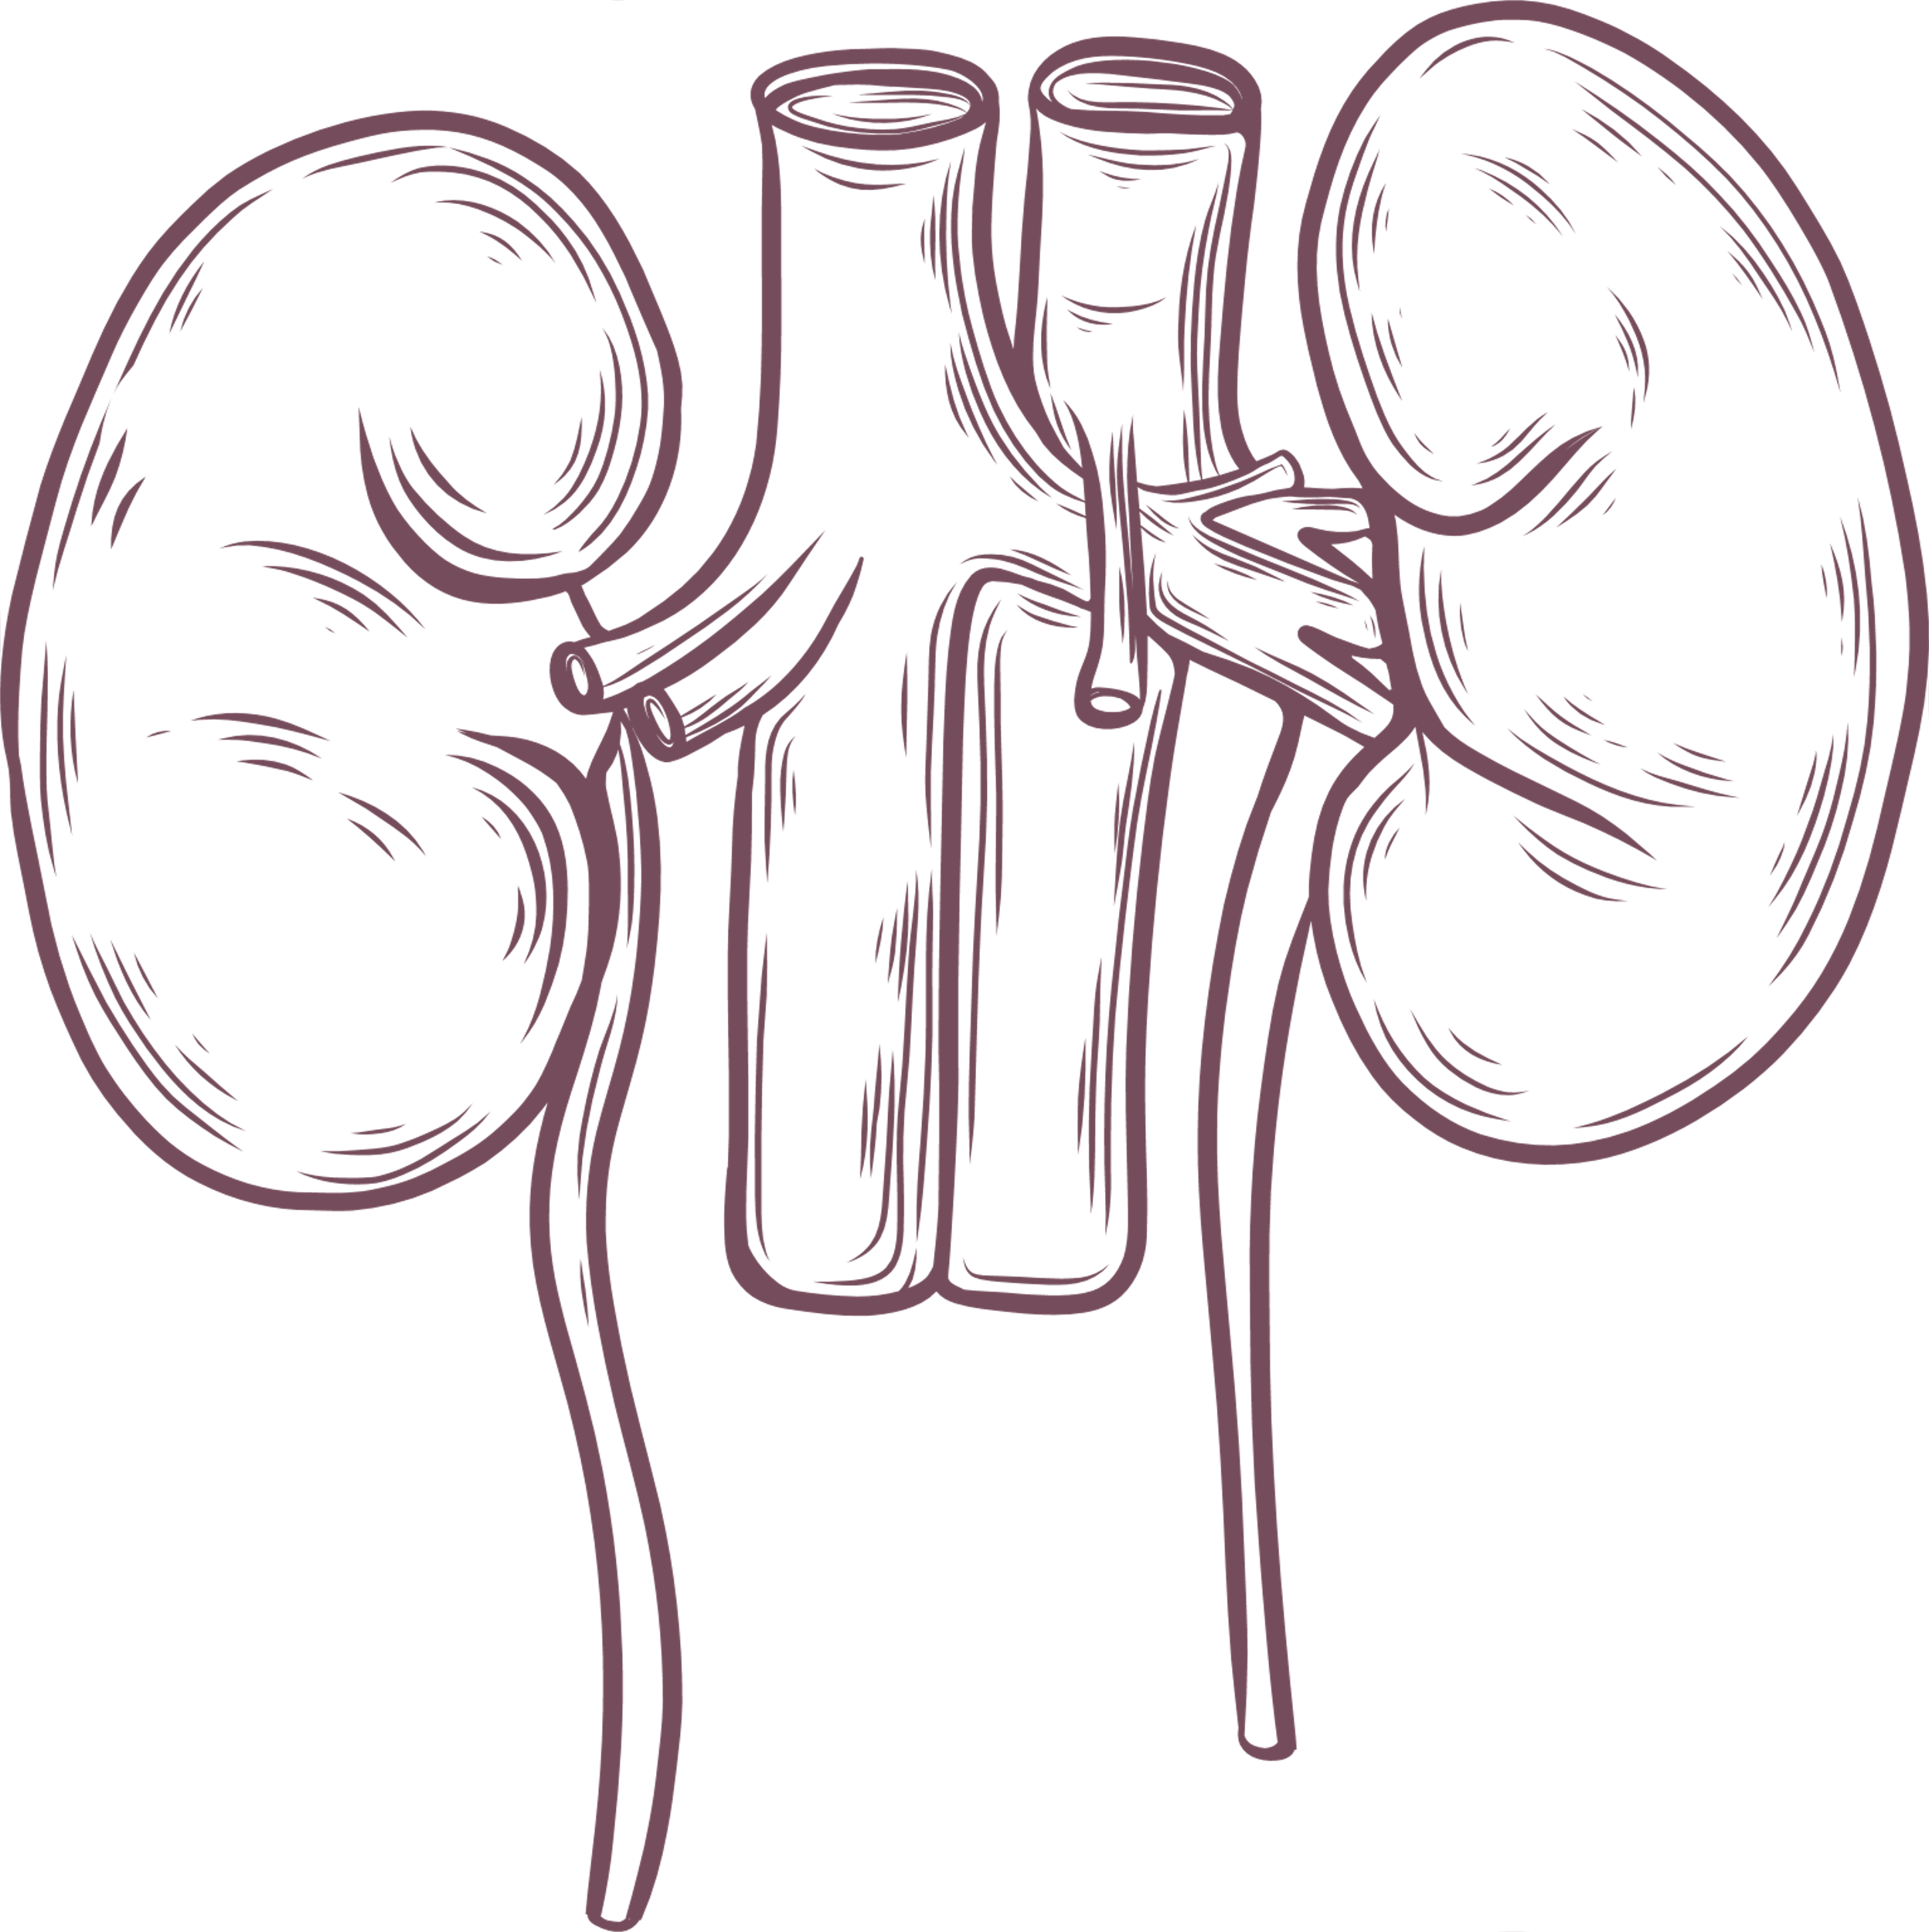
Renal Protection
Reduced progression of diabetic nephropathy (24% risk reduction in composite renal outcomes) (NEJM 2024)
Slower albuminuria rise, stable GFR
Potential direct anti-fibrotic effect (Zhang Y, Front Pharmacol. 2021)

Slide 12
Semaglutide, CKD and Type 2 Diabetes

Slide 13
FLOW Study – 2024

Slide 14
Brain Benefits – Potential Neuroprotection
Neuroprotective in animal models: Reduced amyloid/tau in AD mice (McClean et al., J Neurosci 2011)
Parkinson’s disease trials (Exenatide) show possible motor improvement (Aviles-Olmos et al., J Clin Invest 2013)
Early data on mood/cognition in T2D patients (modest but intriguing)

Slide 15
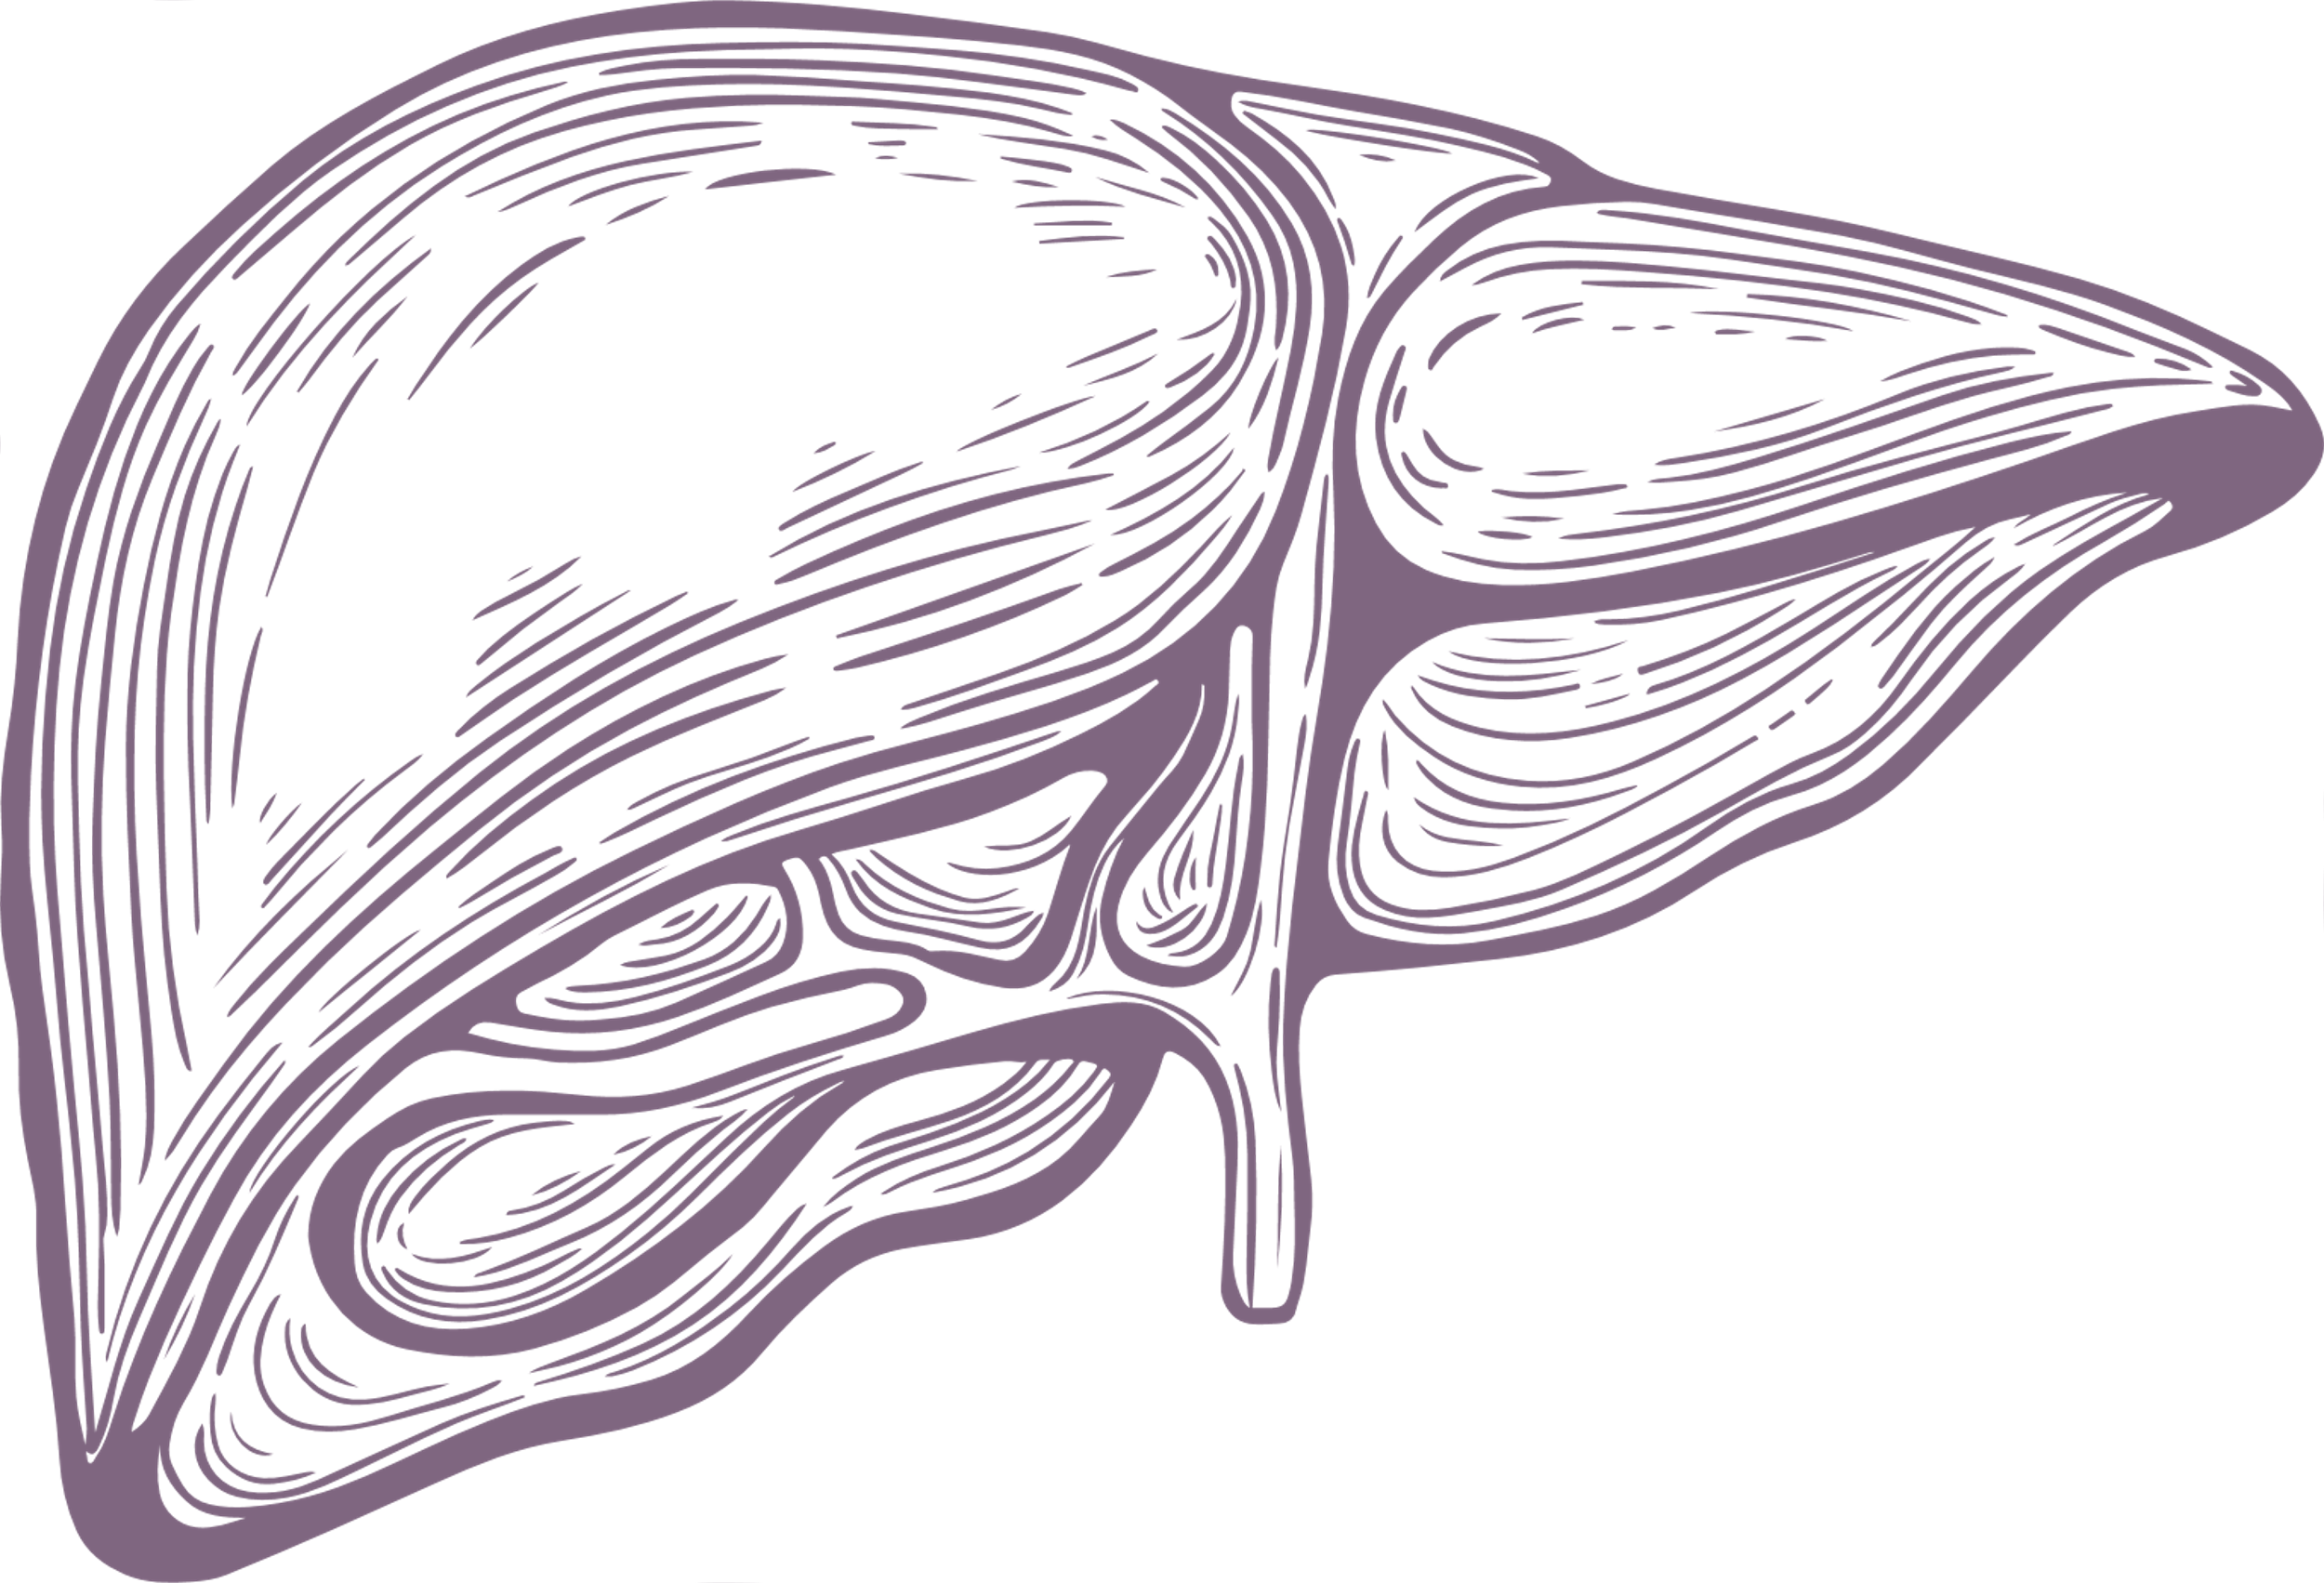
Liver Health – NASH / NAFLD / MASLD
↓ Liver fat by ~8%; semaglutide/liraglutide improve NASH in trials
Tirzepatide may go further – ↓ inflammation, ↓ steatosis
Mechanism: anti-lipogenic, insulin-sensitising, anti-fibrotic
Histology: better ballooning, inflammation, enzymes
Awaiting long-term data on fibrosis reversal for full adoption

Slide 16
GLP-1 Therapies for NASH Treatment
Semaglutide & Liraglutide RCTs: improved NASH in certain patients
Tirzepatide: Greater impact on liver fat & inflammation
Survodutide: Phase 2 trial in MASLD showed reduced fibrosis (NEJM)

Slide 17
Hidden Gems – Bone, Retina, & More
Bone Health: Meta-analysis, long-term GLP-1 RA linked to ↓fracture risk. (Cheng et al, 2019)
Retinal Disease: Reduced rate of exudative & non-exudative AMD (Allan et al, 2025)
Gut Microbiome: Studies show increased Akkermansia, ↑barrier function, ↓Insulin resistance, ↓ Cholesterol (Zhang Q, Appl Microbiol Biotechnol 2020)

Slide 18
Mental Health Benefits
COGNITIVE IMPAIRMENT
SUBSTANCE-USE DISORDERS
PSYCHOTIC DISORDERS
MOOD & ANXIETY DISORDERS

Slide 19
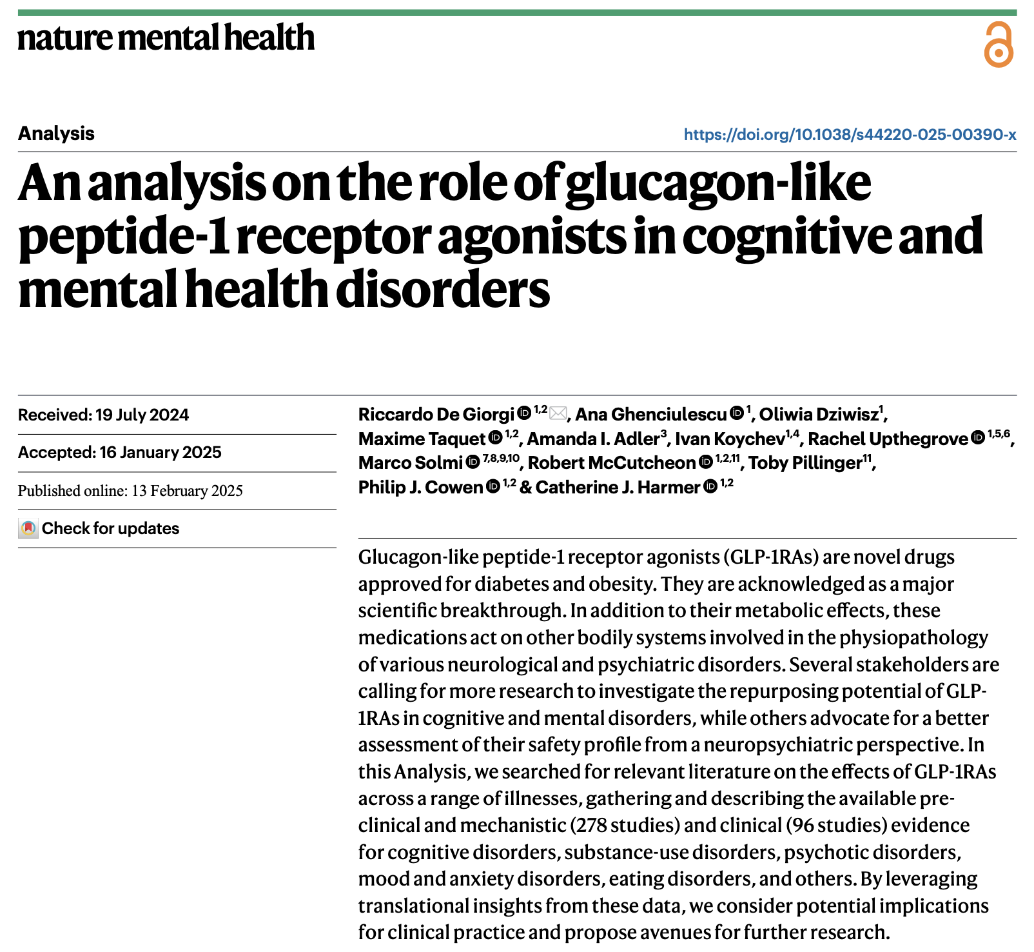
Mental Health Evidence

Slide 20
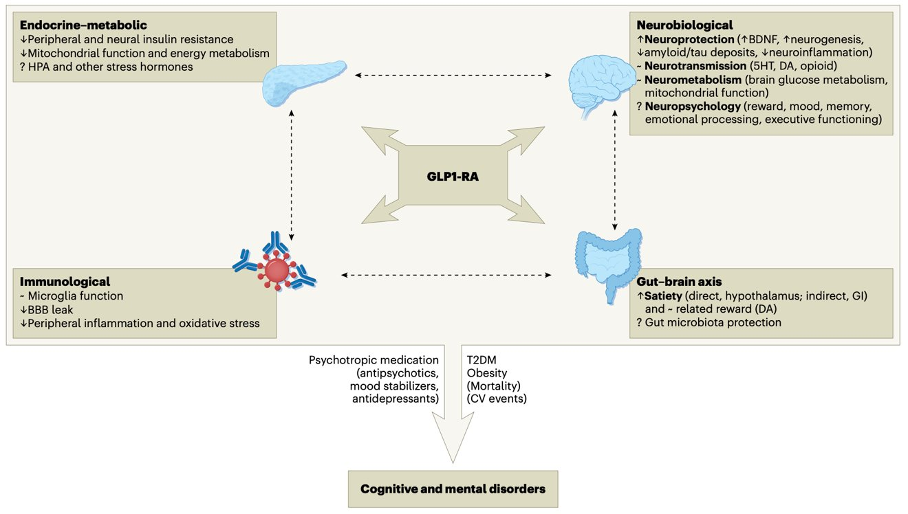
Mental Health - Mechanisms

Slide 21
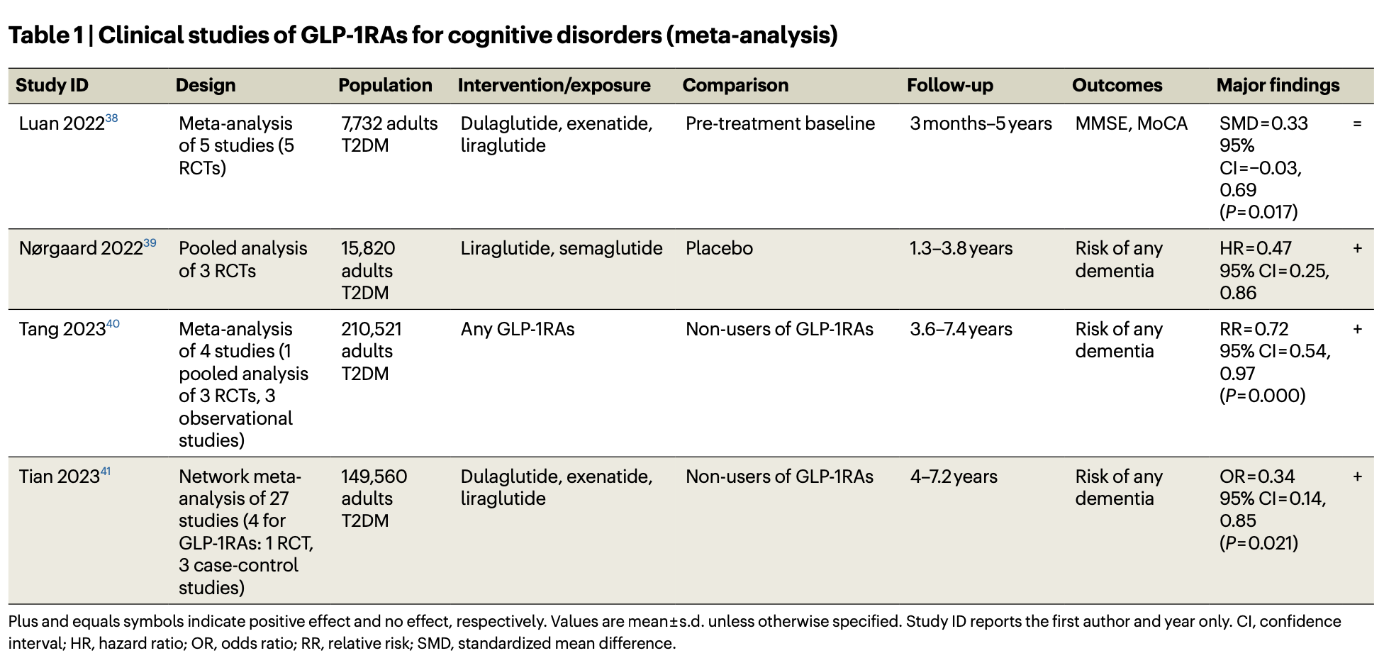
Clinical Studies of GLP-1RAs: Table 1

Slide 22
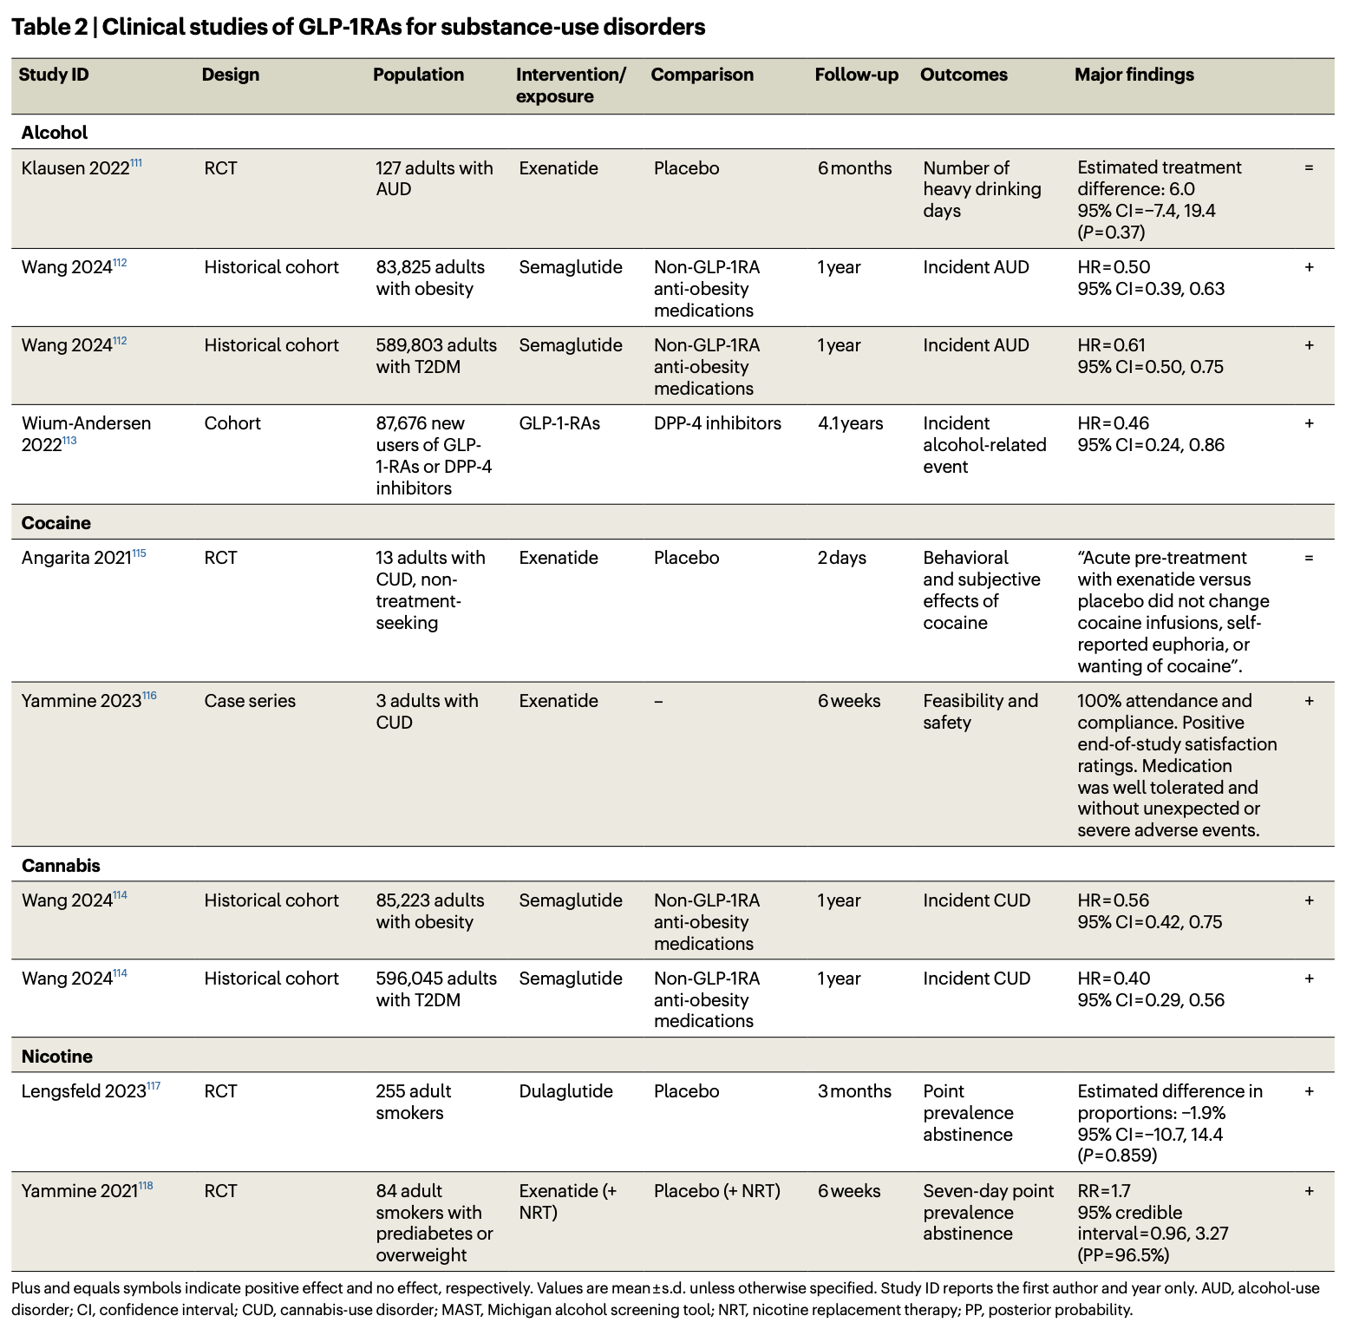
Clinical Studies of GLP-1RAs: Table 2

Slide 23
Conclusion
GLP-1 & GIP peptides are multi-organ protectors, not just sugar/weight fixers
Trials confirm CV & renal benefits; emerging data show promise for liver, brain, bone…
Tirzepatide (& Retatrutide) will push these boundaries even further (pending final outcome data)

